Slide 1

Program: ESE 4009
INSTRUCTOR: Prof. Mike Aleshams
Group 6
Rohan Yadav C0773871 Shahrukh Padaniya C0769542 Swapnil Sevak C0777195 Vandana Ega C0777215
Presented by: SWAPNIL SEVAK

Slide 2

Project : Iot based cradle using SIDS monitor

Slide 3
PCB design layout

Slide 4
What is PCB design layout?
PCB states for printed circuit board.
Our electrical circuits come to life in physical form thanks to printed circuit board (PCB) design.
The PCB design process uses layout software to describe electrical connections on a printed circuit board by combining component placement and routing.

Slide 5
How to design PCB?
It's a good idea to develop a schematic of your circuit before you start designing your PCB.
The schematic will be used to lay out the lines and place the components on the printed circuit board.
Furthermore, the PCB editing program can import all of the components, footprints, and wires into the PCB file, making the design process much simpler.
Here we will use Kicad for PCB design.

Slide 6
What is KiCad ?
KiCad is an open-source electronic design automation software package (EDA). Schematic capture and PCB layout with Gerber output are handled by the applications. The suite is GNU GPL v3 licenced and operates on Windows, Linux, and Mac OS X.
The KiCad project's objective is to offer professional electronics designers with the finest cross-platform electronics design programme available. Although every attempt is made to disguise the complexity of sophisticated design capabilities so that KiCad remains accessible to new and inexperienced users, the demands of professional users are taken into account when defining the project's direction and the importance of new features.

Slide 7
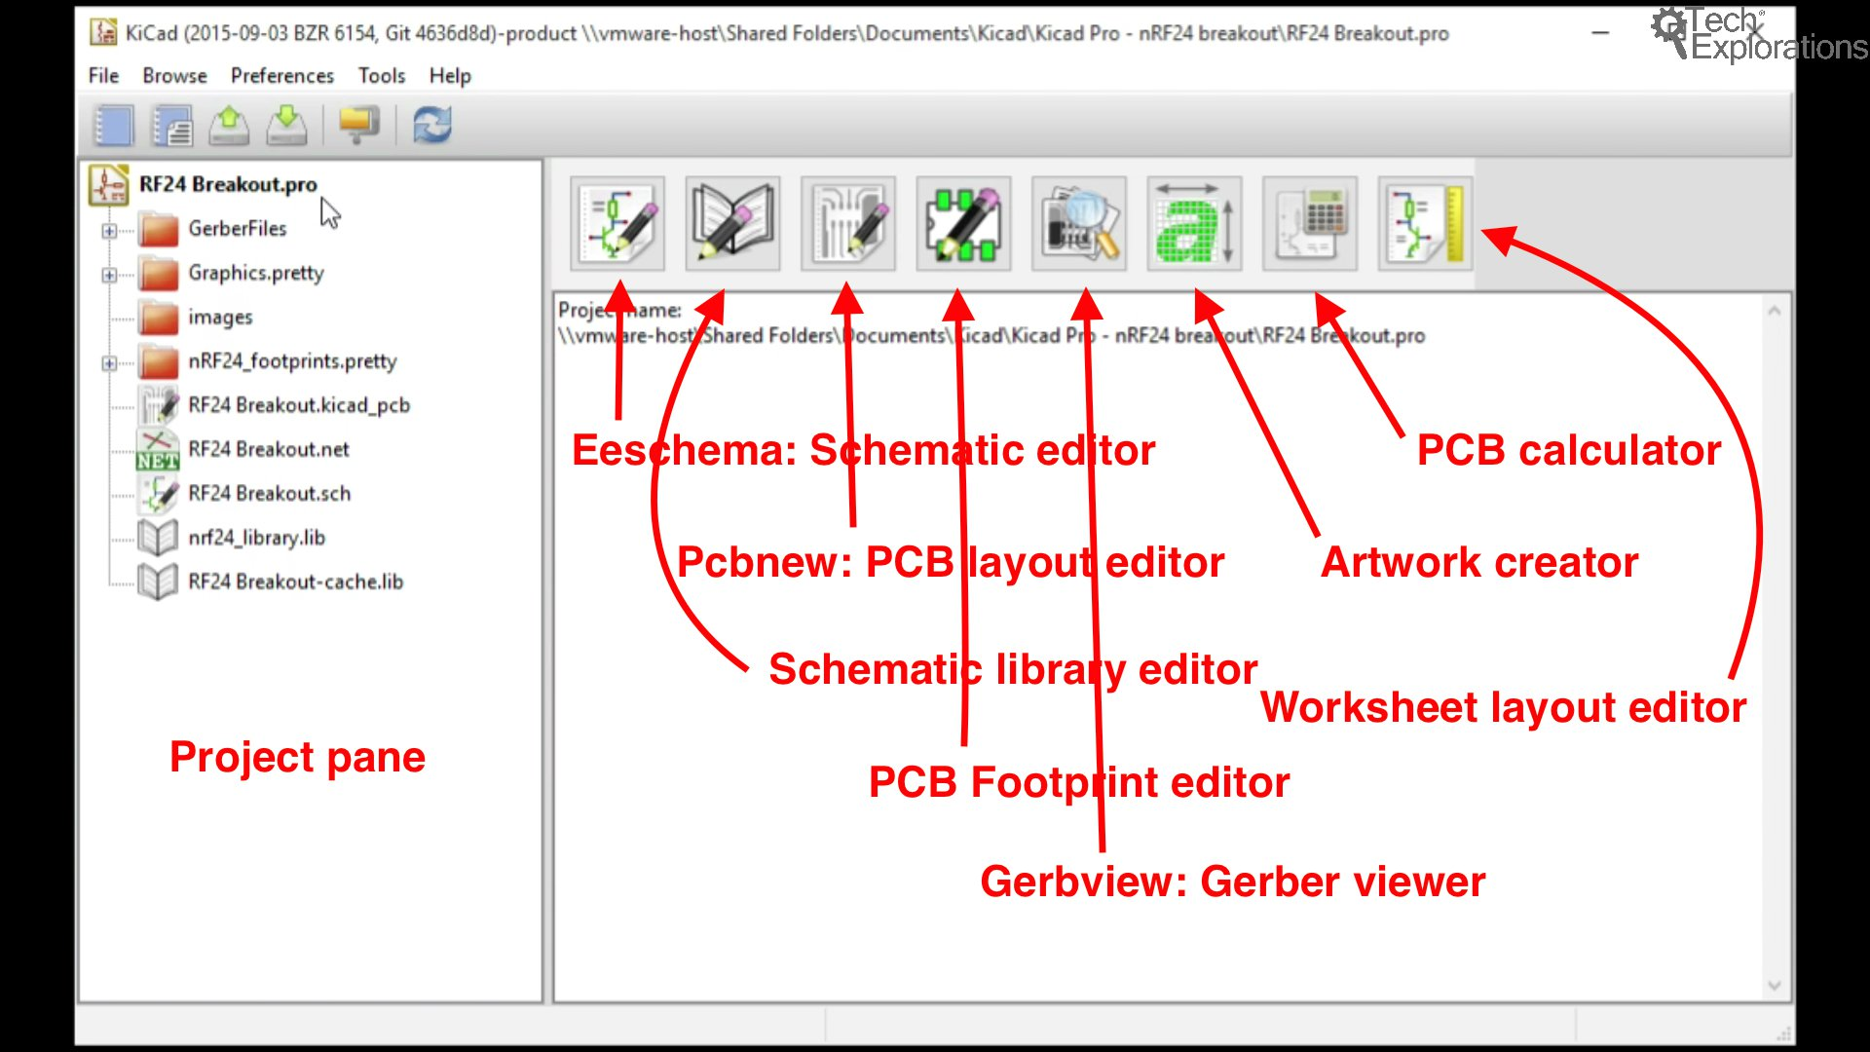
KiCad

Slide 8
Creating a Project
A KiCad project is made up of a number of files that define your printed circuit board (PCB). At least one schematic file describing the PCB's function will be included. This is accomplished by the use of symbols, wires, and labels. This file is used to create the layout's connection information and to specify which footprints will be utilized.

Slide 9
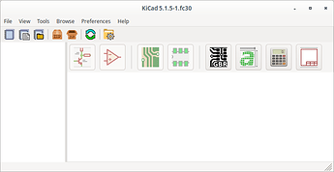
Creating a Project
To begin working on a project, open KiCad like you would any other software. KiCad's primary window will appear. It is used to manage project-level tasks. It may be used to create or open projects, as well as to access the tools needed to modify project files.

Slide 10
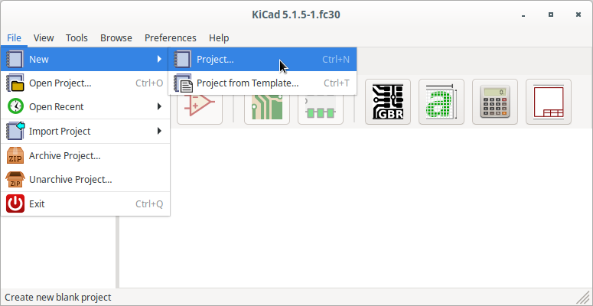
Creating a Project
File->New->Project (or the shortcut crtl+n) can be used to start a new project.

Slide 11
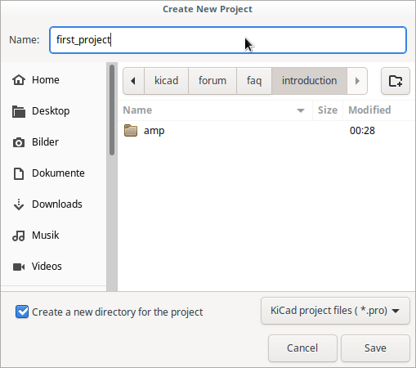
Creating a Project
A file browser-like programme, which is reliant on the operating system, will appear. Navigate to a location where you want to save your project and type the project name (for example, first pcb) into the input area. Select "save" to start the project (or the equivalent for your operating system).

Slide 12
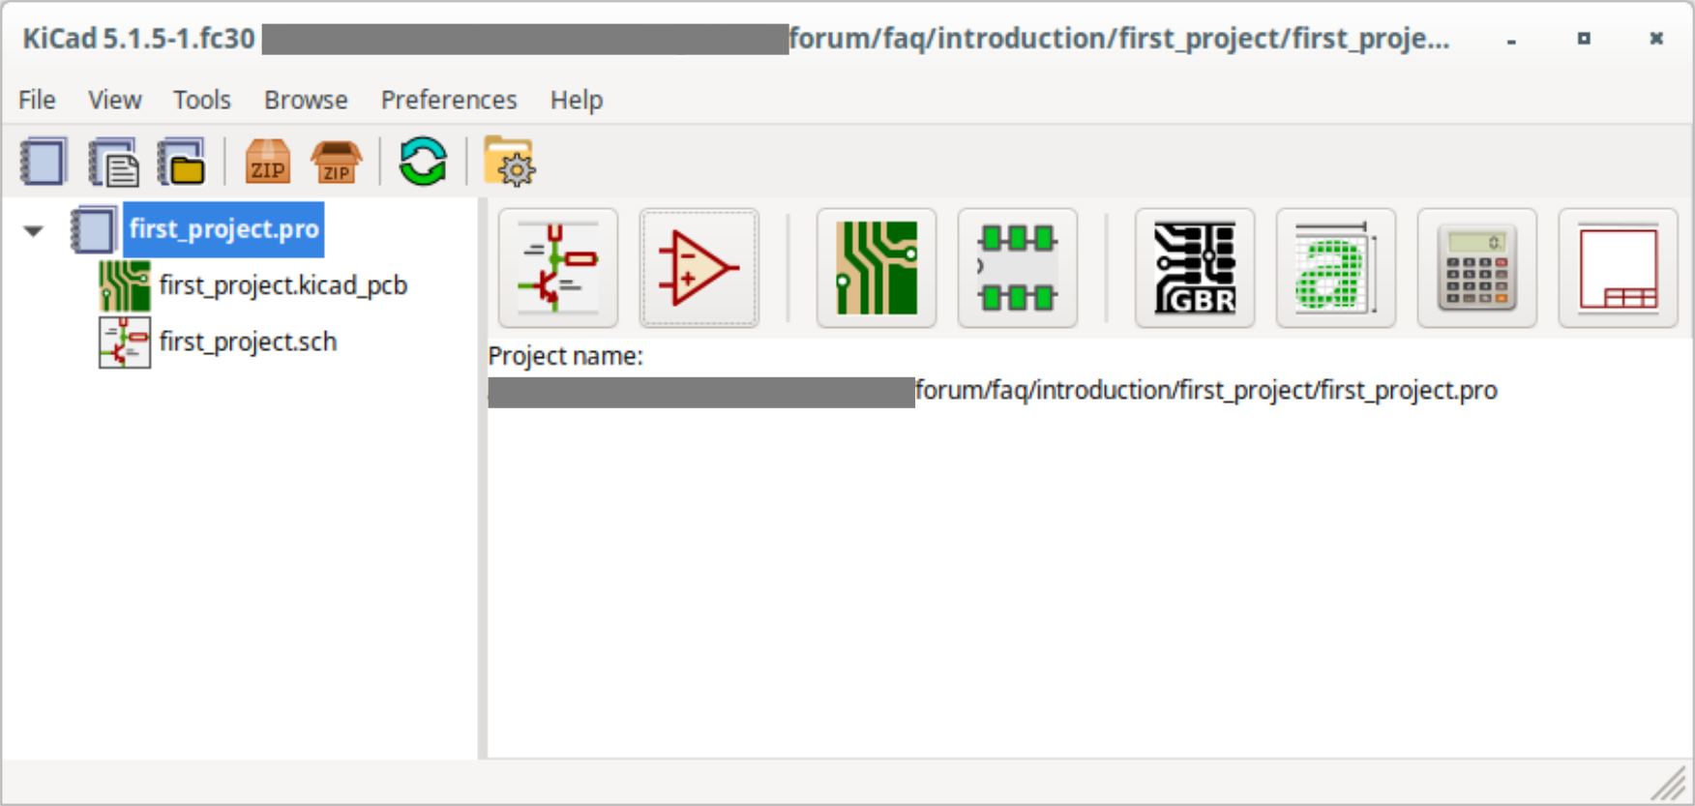
Creating a project
The result will look something like this.

Slide 13
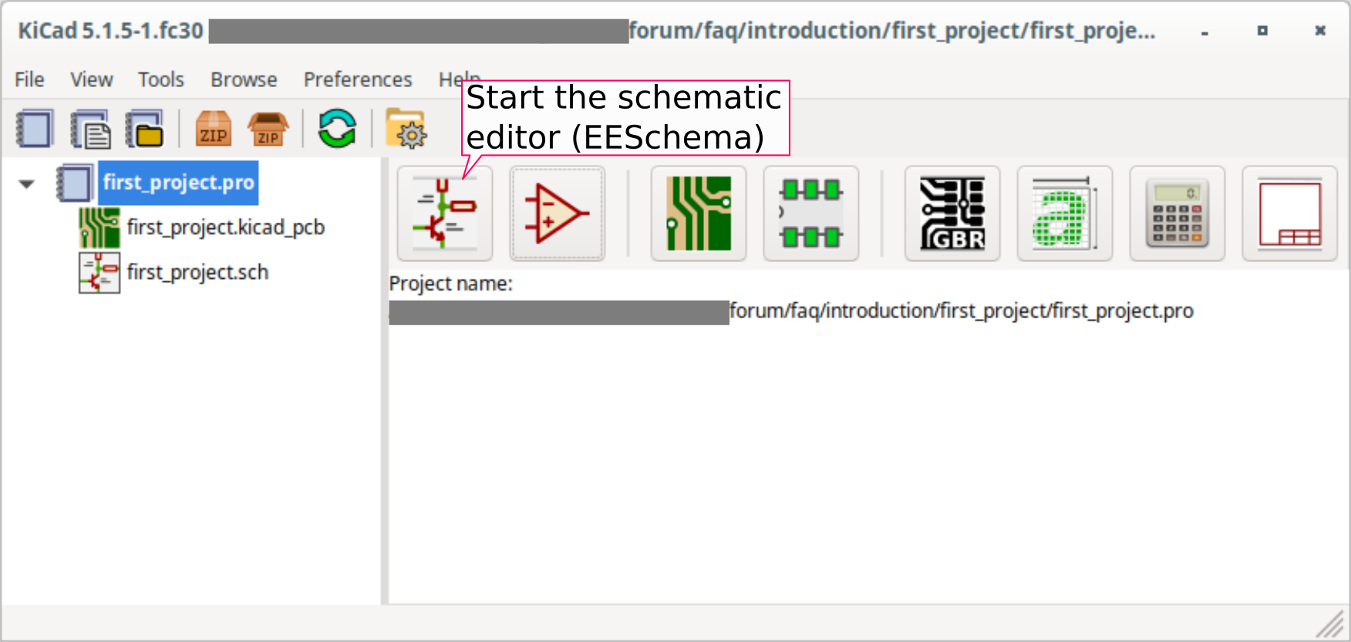
Starting the editor
Open the schematic editor (EESchema) by clicking on the button for the schematic layout editor (leftmost of the large buttons. See screenshot)

Slide 14
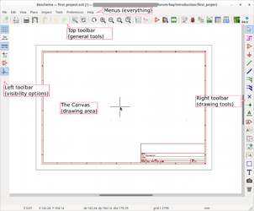
Starting the editor
If this is your first time using EESchema, a popup will appear asking you to configure your libraries. Assume the default setting. If the default option isn't accessible, you didn't instal libraries with KiCad in some way.You will be presented with an empty schematic. In the screenshot that illustrates different portions of EESchema, I have annotated the key bits.

Slide 15
Adding symbol in KiCad
To enter symbol mode, press the add symbol button in the right toolbar (or “place->symbol”). The upper toolbar has a similar button, but that one opens the symbol editor.
After that, click anywhere on the canvas to bring up the add symbol dialogue. Enter the part name in the filter area and single-click the symbol from the results. In the dialogue, you'll now see a preview of the symbol and its details. To add a symbol to the schematic, double-click on the symbol's name or click OK.

Slide 16
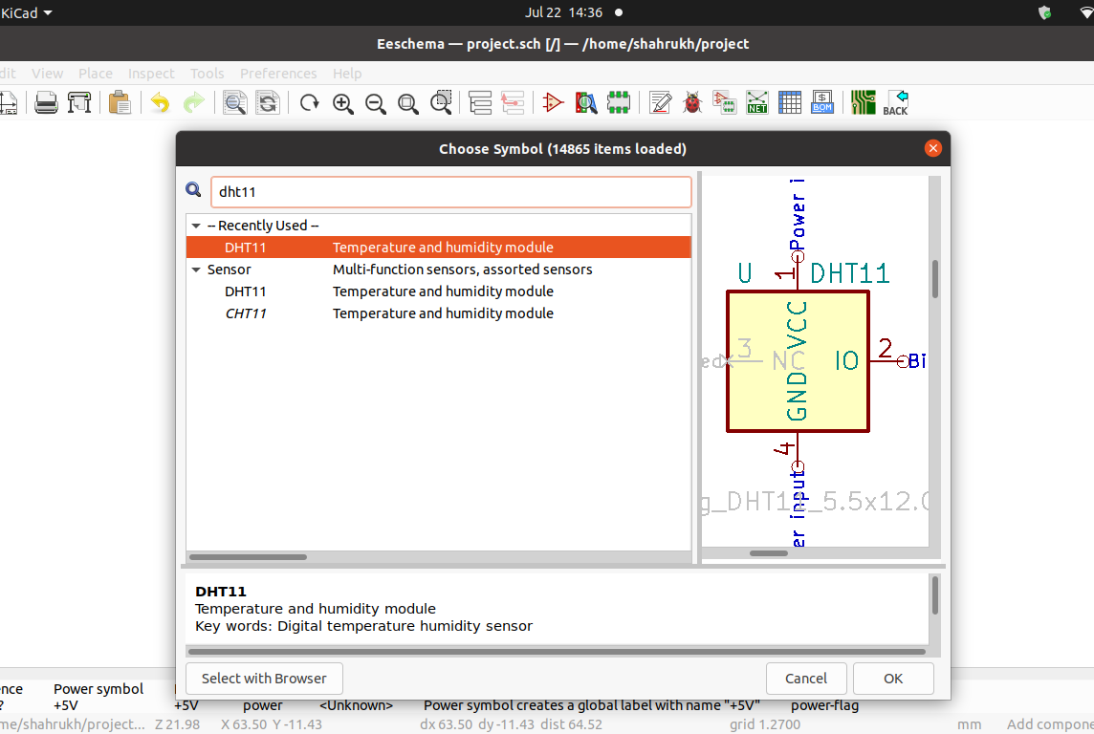
Adding symbol in KiCad - DHT11

Slide 17
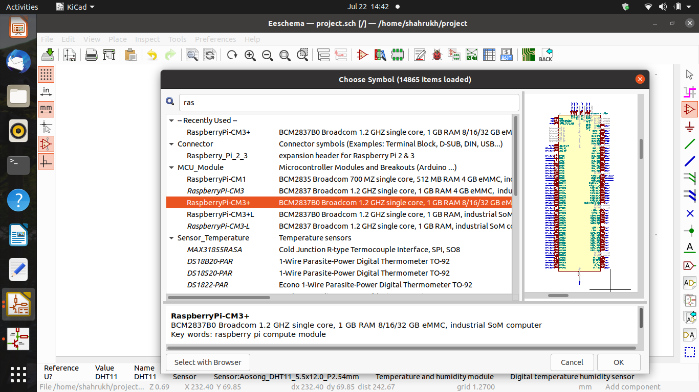
Adding symbol in KiCad – raspberry pi

Slide 18
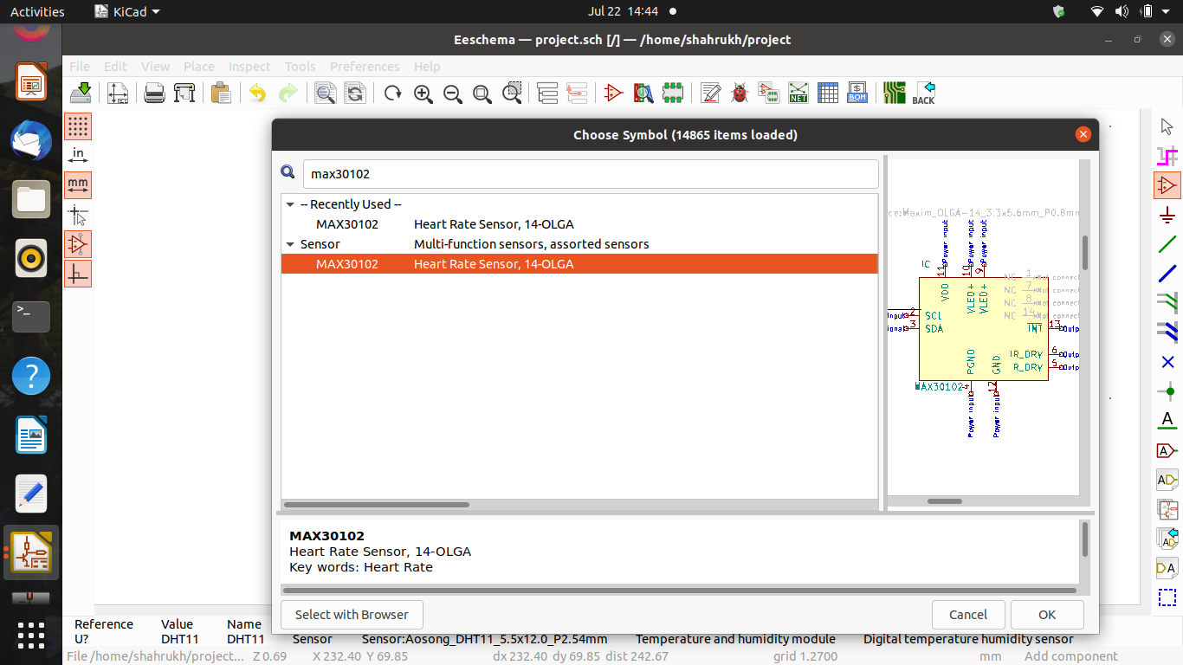
Adding symbol in KiCad – pulse oximeter

Slide 19

Make the Connections
You'll see that your symbols have lines extending out of them with a little circle at the end if you look closely. The circles indicate that this pin is not connected, while the lines are called pins. Wires will be used to make the necessary connections. To do so, use the wire tool from the right toolbar.
Nothing happens at this time, just like with the add symbol tool. Start the wire with a left-click. You'll see that a green line is following you as you move the mouse around.

Slide 20
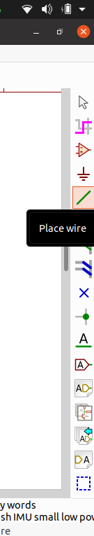
Make the connections:-
To connect, first click on the place area, then on the wire.
Connect the component to a different component now.
Then, click on the end wire.

Slide 21
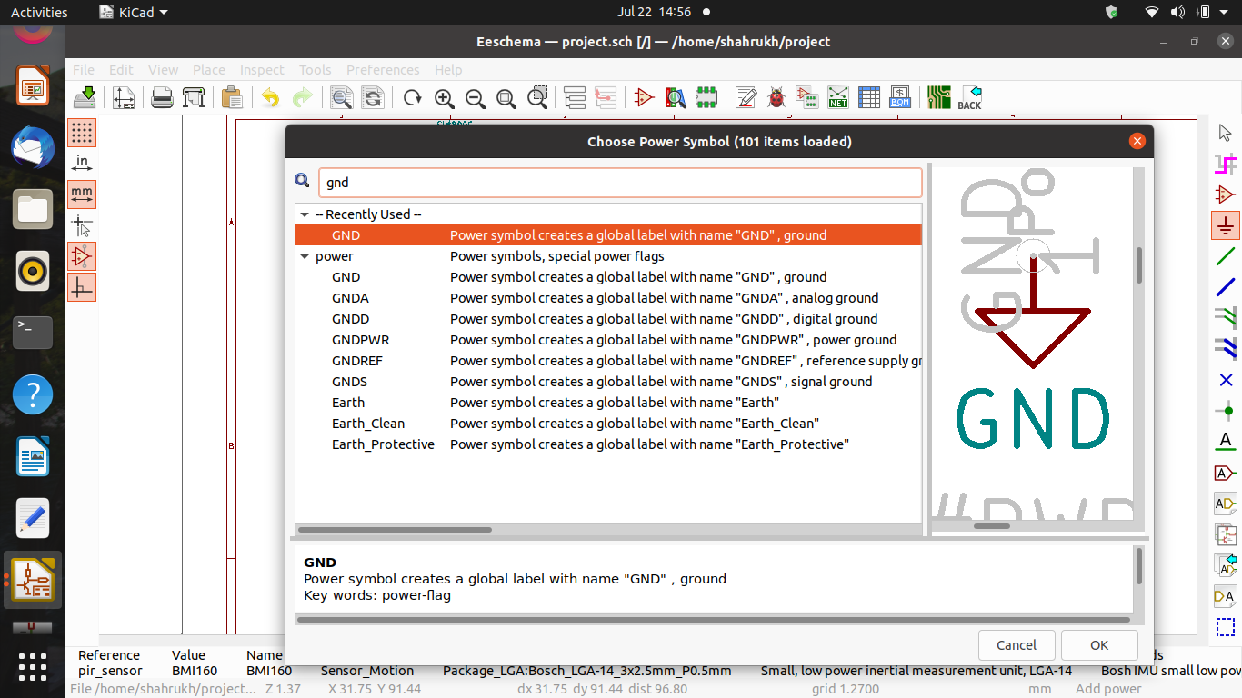
Placing power components:-
To put power components in place, go to location, then power point, and then look for the power component we require, such as ground or Vcc.

Slide 22
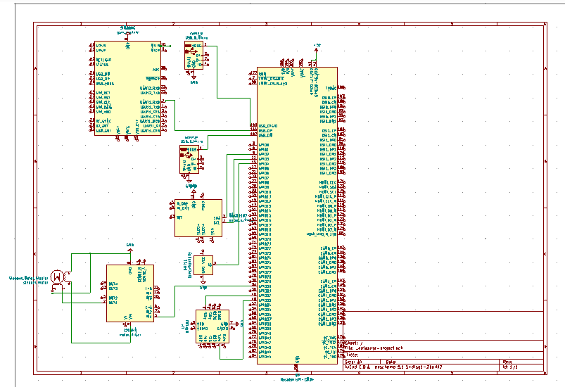
Our schematic diagram

Slide 23
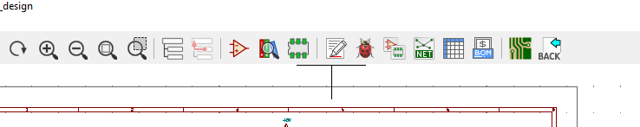
To design PCB
After completing schematic diagram we need to follow steps as below.
We need to add footprints using edit/create footprint function.
Edit/create footprint

Slide 24
To design PCB
After adding footprints we need to click on the function shown in below image to create a PCB layout.
To generate PCB layout

Slide 25
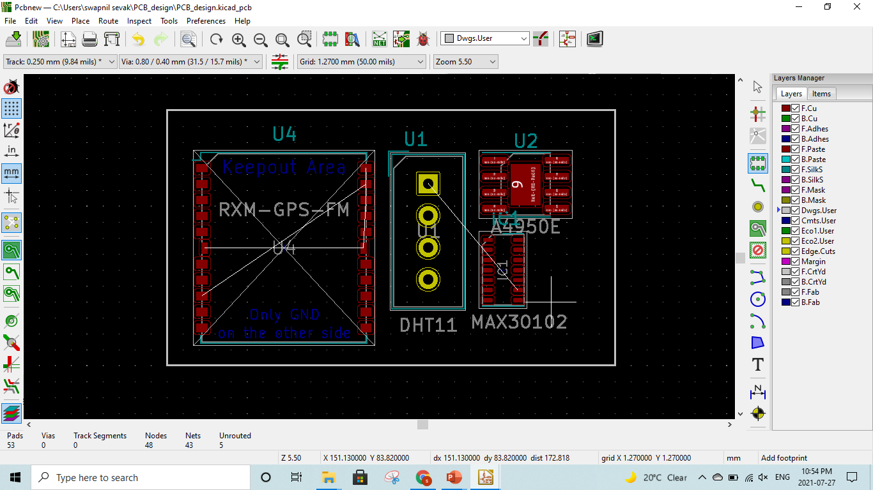
Our PCB layout

Slide 26
References
KiCad EDA Reviews & Product Details (n.d.)
https://www.g2.com/products/kicad-eda/reviews#details
Autodesk. “Autodesk.” Autodesk, 2020, https://www.autodesk.com/solutions/pcb-design-software. Accessed 25 July 2021.
Circuit basics. “Circuit basics.” Circuit basics, 2020, https://www.circuitbasics.com/make-custom-pcb/. Accessed 25 July 2021.

Slide 27
THANK YOU

